Slide 1
Coffee Price Dynamics in the Face of Changing Brazilian Weather
OPIM 5671: Data Mining and Business Intelligence
Presented by:
Lakshmi Ravi Chandu Kolusu

Slide 2
Project Summary
Brazil is the Leading Coffee Producer Worldwide, contributing to one-third of global coffee supply
Industry Faces Increasing Uncertainty due to Climate Change
Impacts Brazil as coffee is 10% of their economy and employs 3.5+ M people
Decrease in Coffee Production → Increase in Coffee Price
Focus on the State Minas Gerais
Largest Coffee Growing State in Brazil (55% of Brazil’s Production)
Objective: Develop a Time Series Forecasting Model to Predict Coffee Prices Based on Climate Variations
Method:
Prewhiten & check the cross-correlation between climate and coffee prices
Model the ARIMAX with the proper lagged effect of climate

Slide 3
Data Manipulation
Subset 2013-01-01 to 2019-12-31→ Avoid Covid
Coffee Price Data:
21 Null Values Range: 2023-05-08 → 2023-08-25
Missing Dates
Added Missing Dates & Forward-Filled Price Values
Brazil Climate Data:
Translated & Renamed Columns from Portuguese to English
Southeast Region & Drop Extra Climate Categories
Humidity, Wind Direction, Latitude, Dew Point, etc.
Subset State = Minas Gerais & Forward-Filled Missing Values
Group By Date & Climate Category then Calculated the Mean/Min/Max
Example Result: Min of Min Air Temp for Each Day (Hourly→ Daily → Monthly)
Combined Data
5 Created Features: Mean_Air_Temp, Min_Air_Temp, Max_Air_Temp, Mean_Precipitation, and Mean_Price

Slide 4
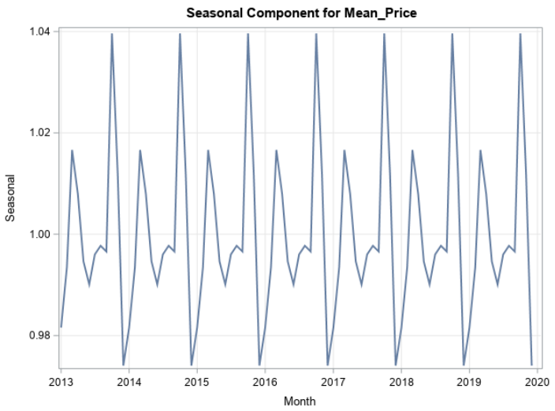
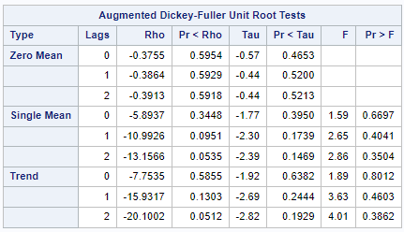
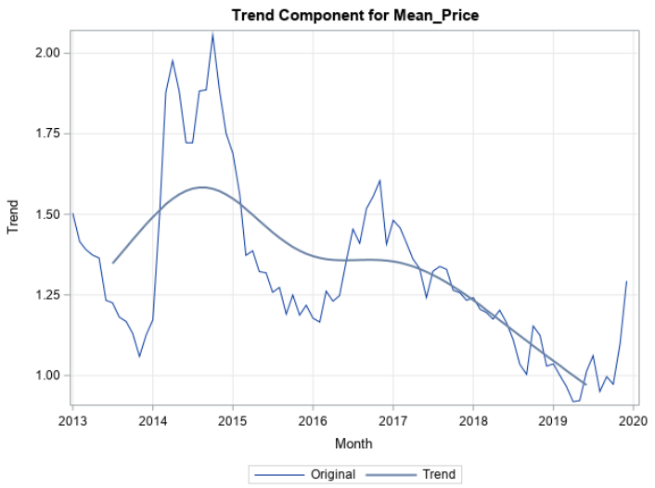
Mean_Price Analysis
The dependent variable "Mean_price" exhibited both seasonality and a trend.
P-value for F, Tau > 0.05: Insignificant
“Non-stationary”

Slide 5
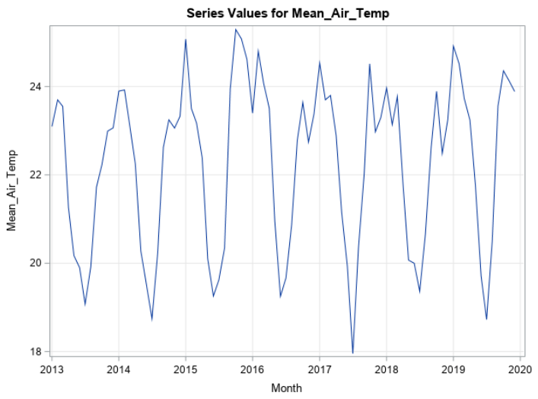
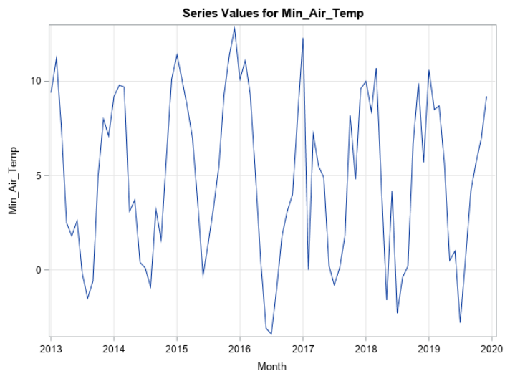
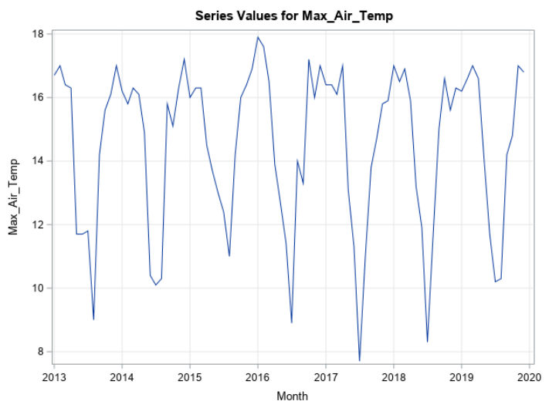
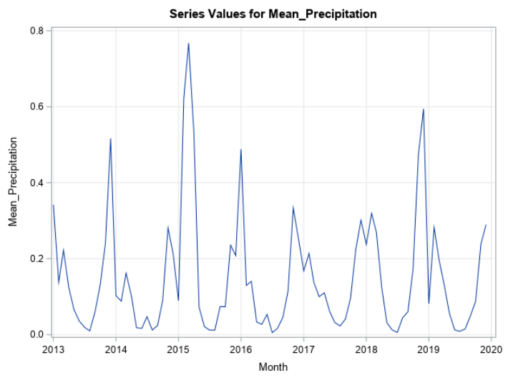
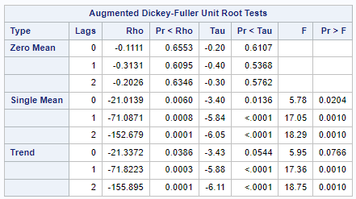
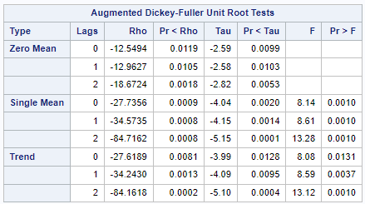
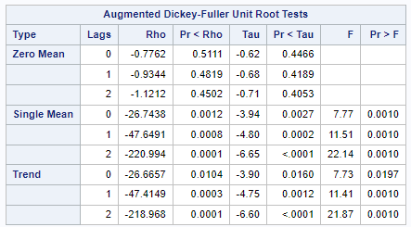
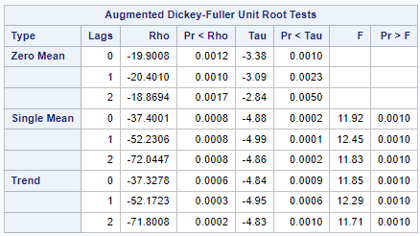
Explanatory Variables Analysis
Explanatory Variables:
Mean_Air_Temp, Min_Air_Temp, Max_Air_Temp, Mean_Precipication
P-value for F, Tau is all Significant.
No Trend observed but Strong Seasonality exists.

Slide 6
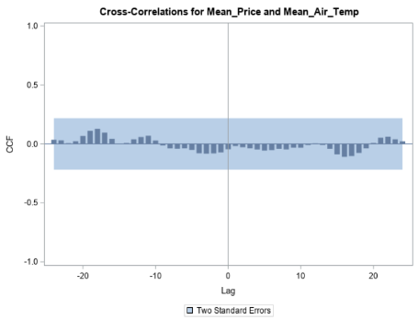
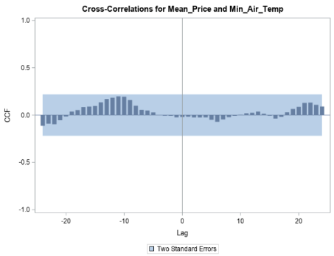
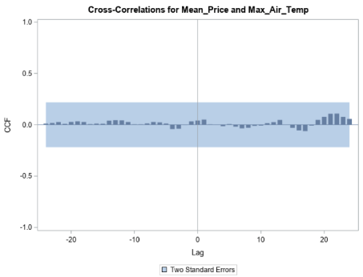
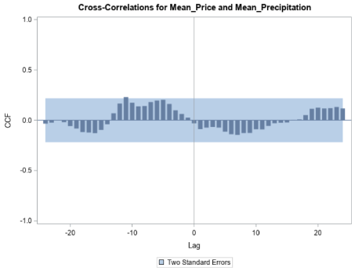
CCF Analysis: Before Prewhitening
“No lag effect observed”

Slide 7
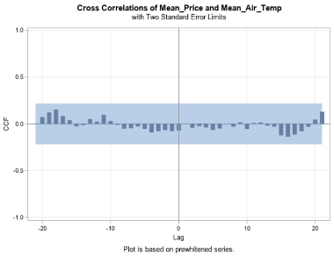
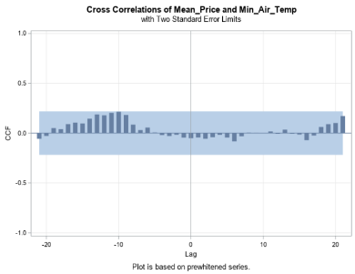
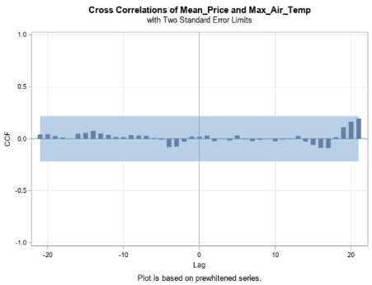
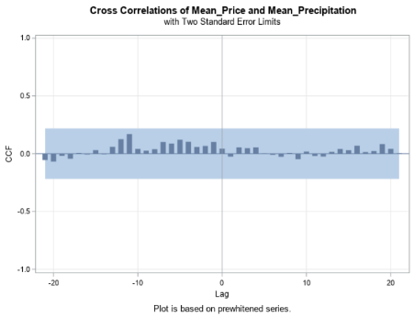
CCF Analysis: Prewhitening Result
“Still No lag effect observed”
Notes:
fit best models for all x variables and then checked for fit stats aic n sbc and checked for residual white noise.
and applied same model for y variable individually in combi with best x models and checked.

Slide 8
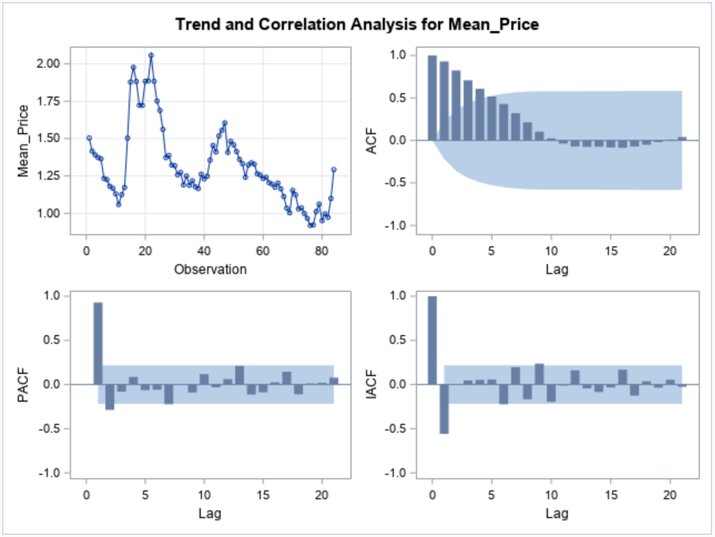
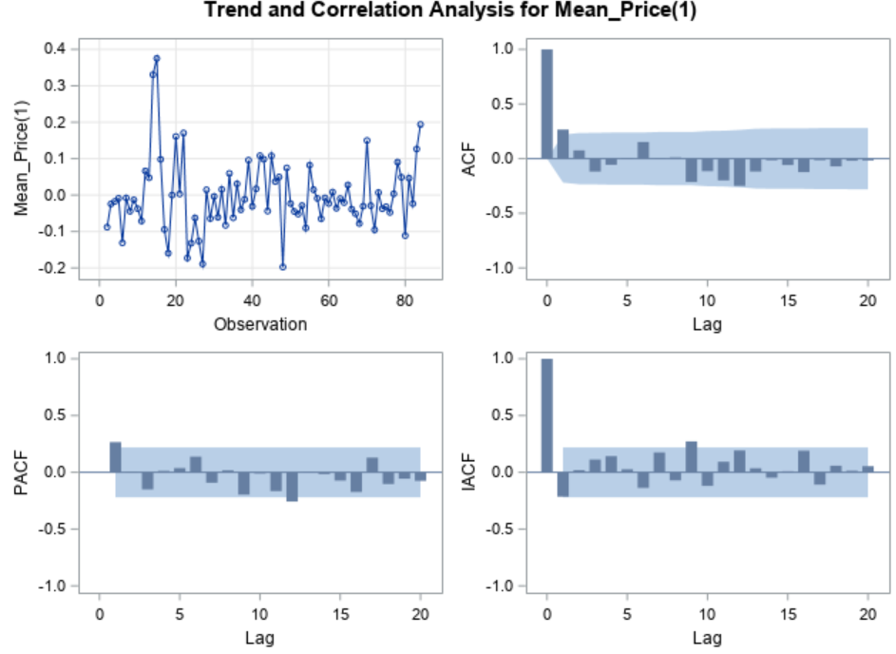

Mean_Price (d=1)
Applied first-order differentiation to make data stationary
The data seem to hover around a constant mean and exhibit constant variance.
No apparent trend in the data.
Autoregressive order of 1
P-value for F, Tau < 0.05: Significant
“Stationary”
Notes:
The ACF plot shows a pattern of gradually declining autocorrelation as lags increase.
In PACF plot first lag is the only clearly significant lag, which implies an autoregressive order of 1
Unit root test

Slide 9
Model Selection
X | AR (p) | I (d) | MA (q) | Holdback Period | MAPE | MAE | MSE | RMSE | AIC | SBC | Residual White Noise
ALL X | 1 | 1 | 0 | 12 | 8.62% | 0.096133 | 0.022133 | 0.14877 | -149.048 | -134.535 | Yes
ALL X | 2 | 1 | 0 | 12 | 8.05% | 0.089978 | 0.020043 | 0.14157 | -147.159 | -130.228 | Yes
MAX_TEMP | 1 | 1 | 0 | 12 | 7.54% | 0.084292 | 0.018702 | 0.13675 | -154.987 | -147.731 | Yes
MEAN_PRECIP | 1 | 1 | 0 | 12 | 7.88% | 0.08751 | 0.018341 | 0.13543 | -153.504 | -146.248 | Yes
MEAN_TEMP & MEAN_PRECIP | 1 | 1 | 0 | 12 | 7.74% | 0.086097 | 0.018104 | 0.13455 | -151.694 | -142.019 | Yes
Notes:
Fit statistics for AR1 n 2 comparison as the data is same and no changes in x variables
Multicollinearity btw temp variables(moderate correlation) and no correlation for precip
less x variables for less complex model. Finally with accuracy and it is tricky bcz of underfitting.
so checked if predicted values are falling behind actual values. ruledout it by outofsample forecast graph.

Slide 10
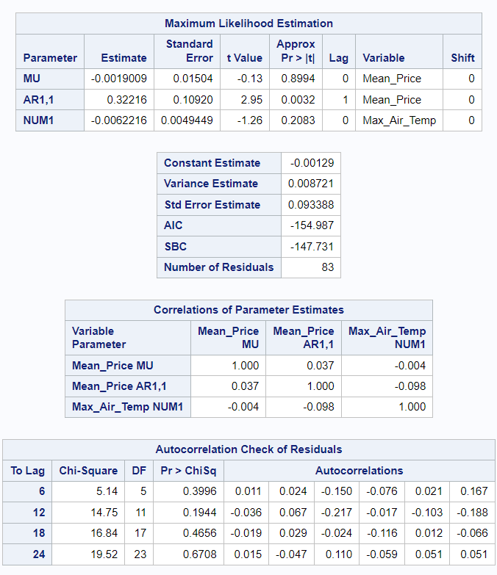
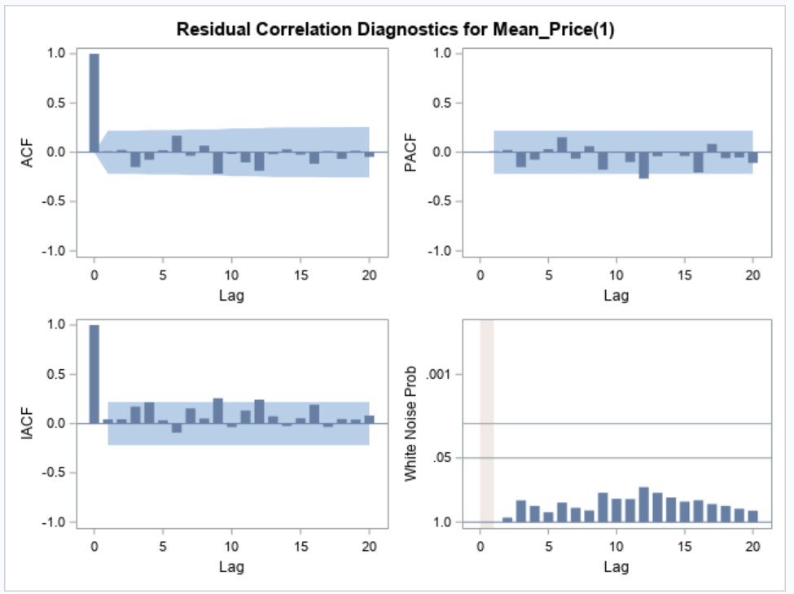
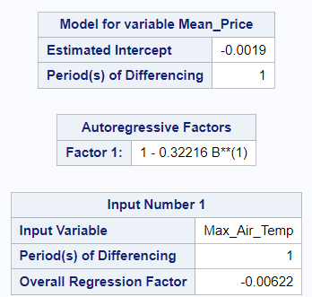
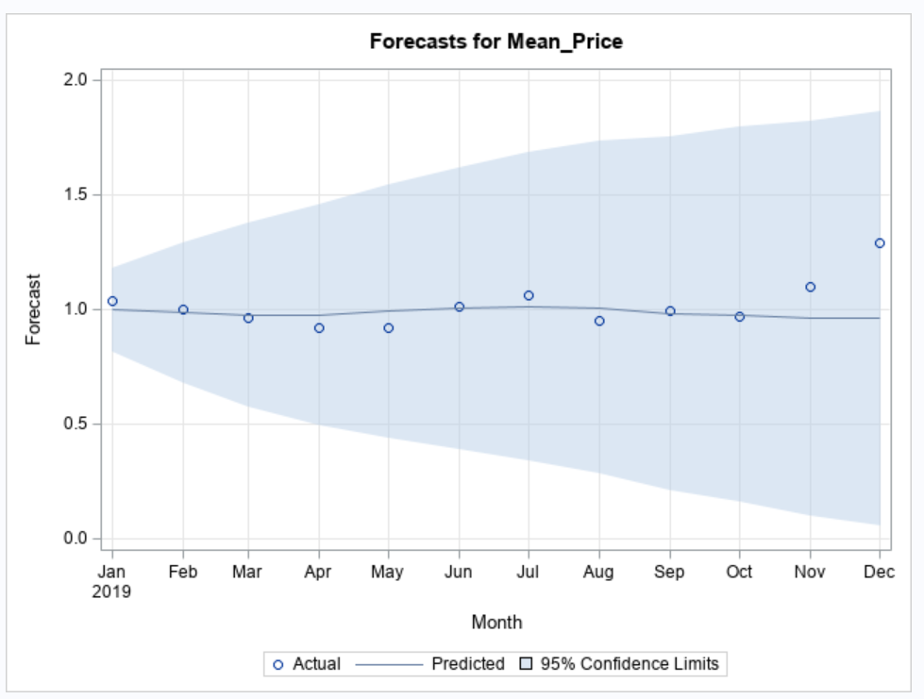
Final Model: ARIMAX (1,1,0) with Max_Air_Temp

Slide 11
Conclusion
While the final model shows reasonable forecasting accuracy, it does not establish a significant correlation between climate features and coffee prices.
Possible Reasons: (1) Threshold Effects (2) Resilience to Moderate Variations (3) Market Factors
Increase timeframe to include more variance in temperature and precipitation
Include alternative factors that could influence coffee prices
Look at air pressure each day
Coffee is grown at high altitudes (low air pressure)
Suggested Next Steps

Slide 12

Thank you

Slide 13
Appendix

Slide 14
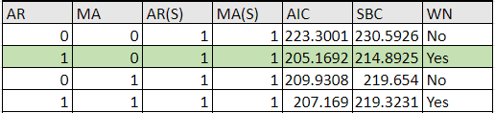
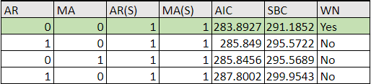
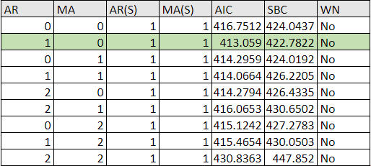
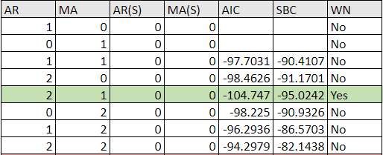
CCF Analysis: Prewhitening
1. Mean_Air_Temp
3. Max_Air_Temp
2. Min_Air_Temp
4. Mean_Precipitation

Slide 15
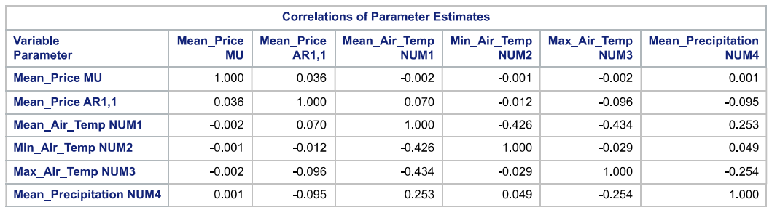
Correlation of Mean_Air_Temp with Max & Min_Air_Temp:

Slide 16
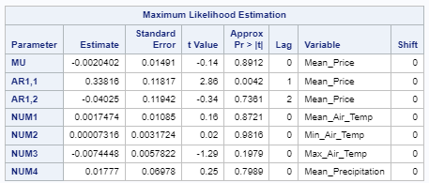
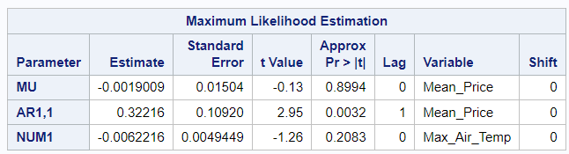
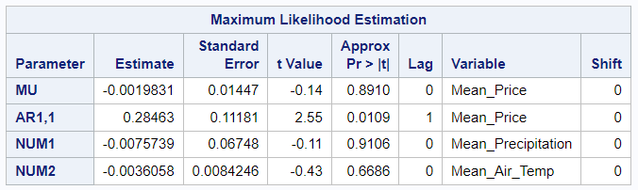
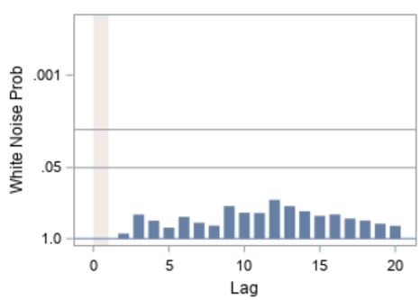
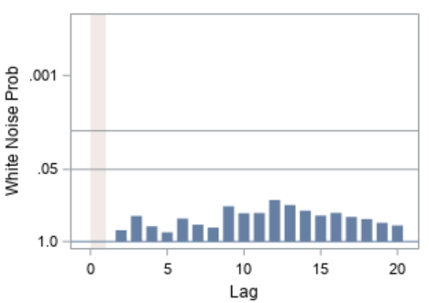
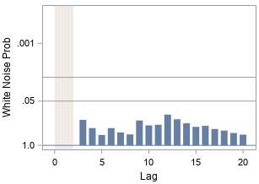
Model Comparison
Max_Air_Temp ARIMAX (1,1,0) | Mean_Air_Temp, Mean_Precipiation ARIMAX (1,1,0) | All Variables ARIMAX (2,1,0)

Slide 17
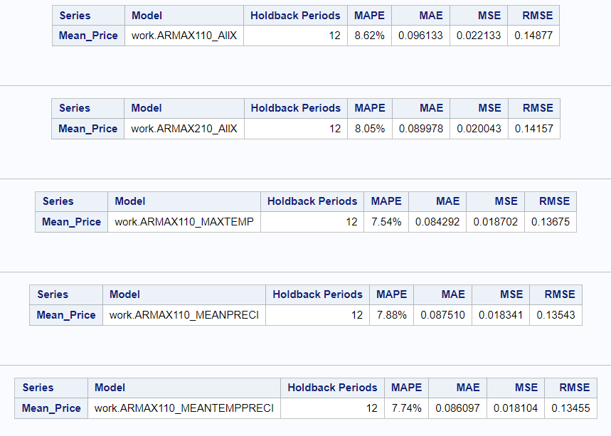
Model Accuracy Comparison
1. All X variables, AR=1, I=1
2. All X variables, AR=2, I=1
3. Max_Air_Temp, AR=1, I=1
4. Mean_Precipitation only, AR=1, I=1
5. Mean_Air_Temp &
Mean_Precipitation, AR=1, I=1

